Slide 1
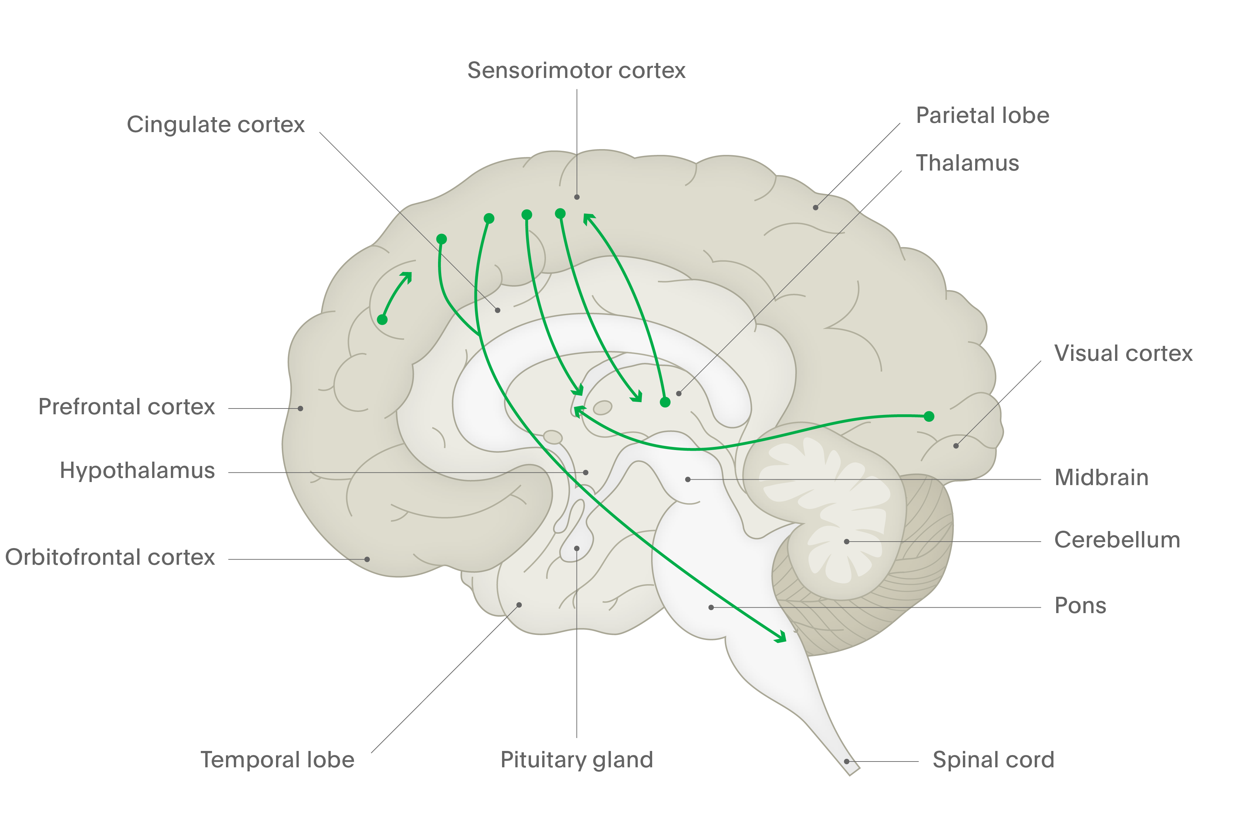
Glutamate
O
O
Mental Health
HO
OH
NH₂
Thalamo–cortical glutamate pathways²
This pathway innervates pyramidal neurones in the cortex
Glutamate is the principal excitatory neurotransmitter in the CNS¹
Glutamate is an amino acid that is produced from glutamine¹
Glutamate is removed from the synapse by transporters on glial cells, metabolised to glutamine, then resupplied to the relevant neurone terminals¹
Cortico–thalamic glutamate pathways²
Cortico–cortical glutamate pathways²
These can be direct, or indirect via GABA neurones
Cortico–striatal glutamate pathway²
Cortico–brainstem glutamate projection²
Regulates neurotransmitter release from the brainstem
Hippocampal–striatal glutamate pathway²
CNS = central nervous system
1. Purves et al. Neuroscience. 4th edition. 2008; 2. Stahl. Stahl’s Essential Psychopharmacology. 2013
Notes:
Control of the CNS can be thought of in terms of a balance between ‘go’ (excitatory) and ‘stop’ (inhibitory) signals.[Purves et al., 2008; Stahl, 2013] If the sum of the ‘go’ signals that a neurone receives outweighs the sum of the ‘stop’ signals, then that neurone will exist in an active state, and will continue to signal to the downstream neurone.[Purves et al., 2008; Stahl, 2013] The main excitatory neurotransmitter in the CNS is glutamate; the main inhibitory neurotransmitter is gamma-aminobutyric acid (GABA).^{[Purves et al., 2008]}
Glutamate is arguably the most important neurochemical for normal brain function.^{[Purves et al., 2008]} Nearly all excitatory neurones in the CNS are glutamatergic – more than half of the neurones in the brain.^{[Purves et al., 2008]} It is noteworthy, though, that high concentrations of glutamate are neurotoxic.^{[Purves et al., 2008]} There are three types of receptor to which glutamate can bind (named after the agonists that activate them), each of which has slightly different properties:^{[Purves et al., 2008]}
NMDA (N-methyl-d-aspartate)
AMPA (α-amino-3-hydroxyl-5-methyl-4-isoxazole-propionate)
kainate (kainic acid).
References:
Purves D, Augustine GJ, Fitzpatrick D, et al. (eds). Neuroscience. 4th edition. Sinauer Associates, 2008.
Stahl SM. Stahl’s Essential Psychopharmacology. Neuroscientific Basis and Practical Applications. 4th edition. © Cambridge University Press, 2013.

